Slide 1

Apple
Georgia zavou & ilaria curzi

Slide 2

SWAT ANALYSIS

Slide 3

STRENGTHS
Strong Brand
Design
Top Technology and Innovation: Known for cutting-edge technology and continuous innovation.
Integrated Ecosystem: Easy integration across all Apple devices.
Customer Loyalty: High customer satisfaction and repeat purchases.
Software & Hardware Integration: Apple controls both hardware and software, resulting in optimized performance and user experience.

Slide 4
WEAKNESSES
Price
Closed Ecosystem
Supply Chain: Relies on manufacturing partners and suppliers from China.
Allegations of Tracking: Apple has faced criticism over data collection and app tracking transparency.
Limited Advertisements and Promotions: Lower use of aggressive marketing or discounting strategies compared to competitors
Dependence on iPhone Sales

Slide 5
OPPORTUNITIES
Expansion into Services: Growing sectors like Apple TV+, iCloud, Apple Music, Apple Pay, and Fitness+.
AI Integration: Upgrades to Siri.
Healthcare Tech
Smart wearable technology: Expanding product lines like Apple Watch, Vision Pro, and AirPod
Expansive Distribution Network: Continued retail expansion and strong partnerships with third-party sellers worldwide.

Slide 6

THREADS
Intense Competition
Economy: Global downturns may reduce demand for luxury devices.
Security & Privacy Concerns: As data becomes more sensitive, Apple faces constant cybersecurity threats.
Supply Chain Disruptions

Slide 7

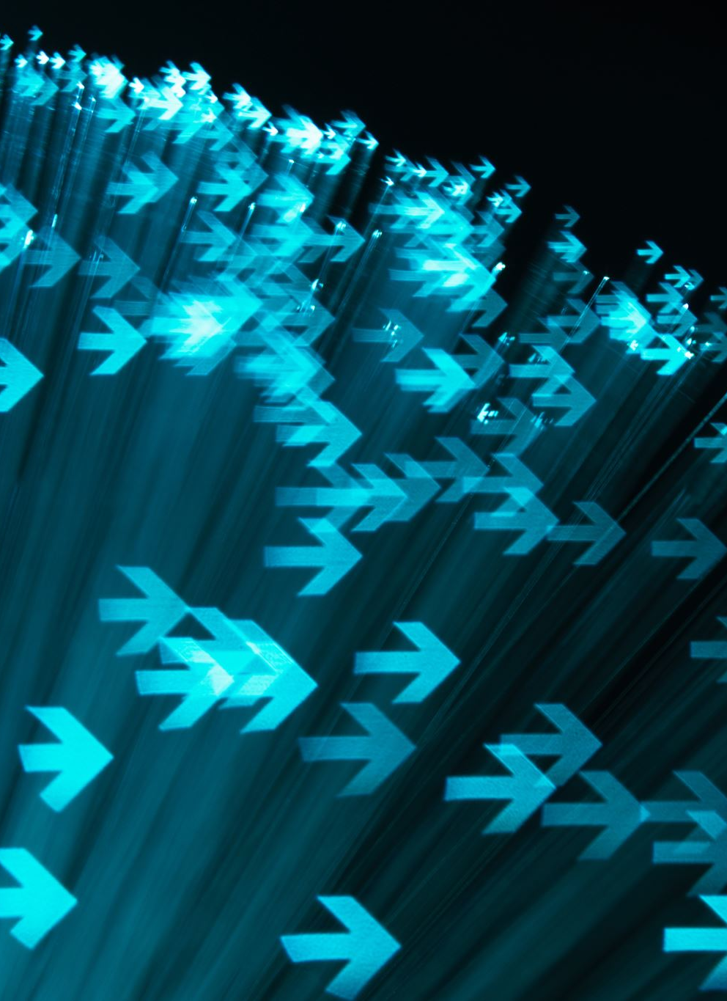
Growth - Share Matrix
The Growth-Share Matrix is a tool used by businesses to analyze their products or services.
It helps companies decide where to invest, which products to grow, and which ones to phase out.

Slide 8


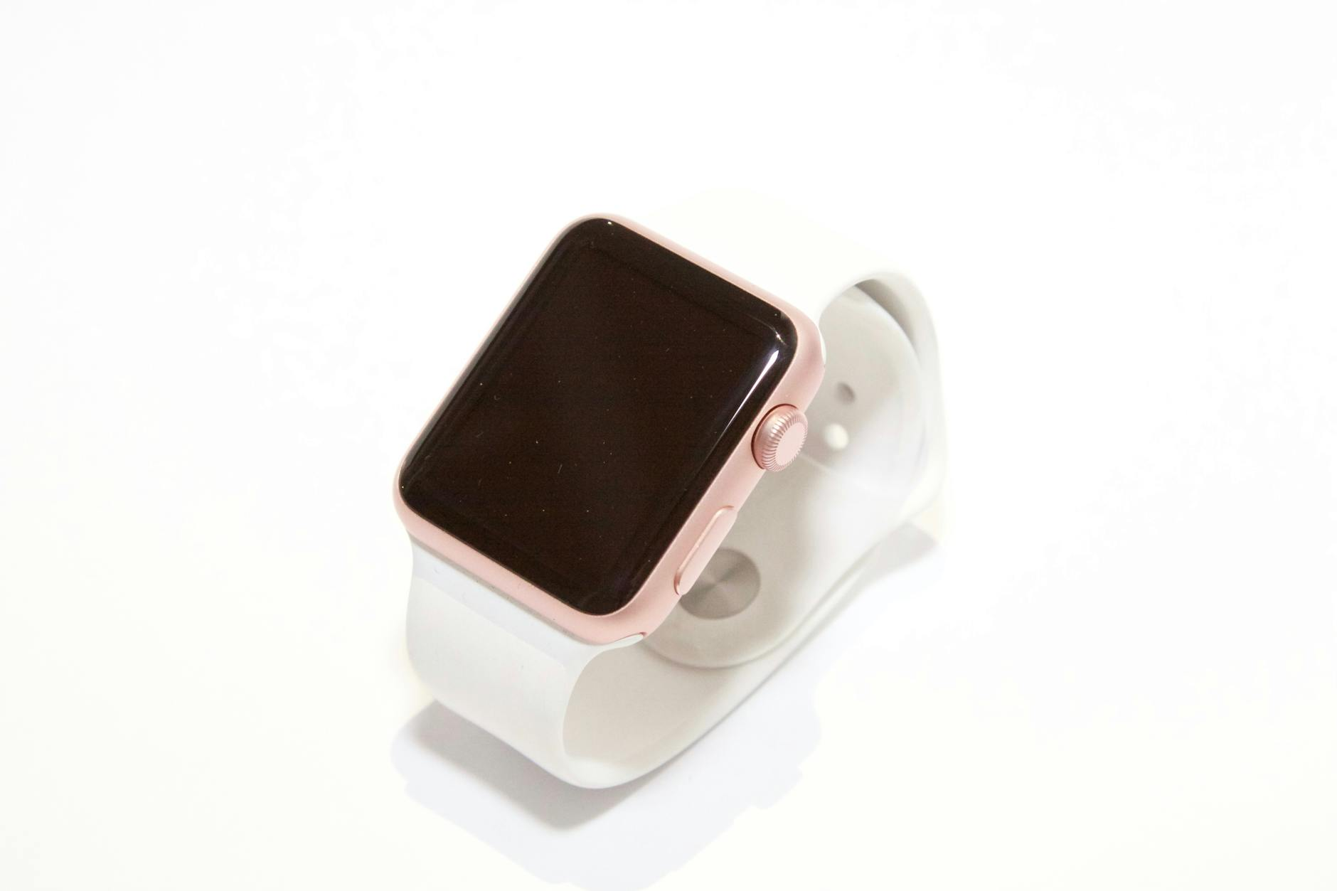

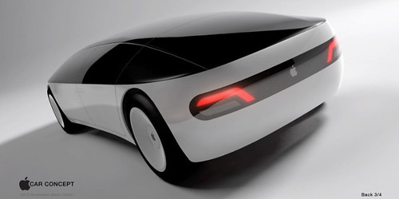
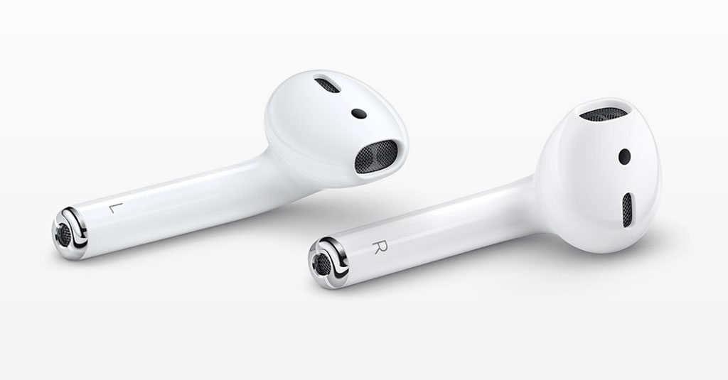


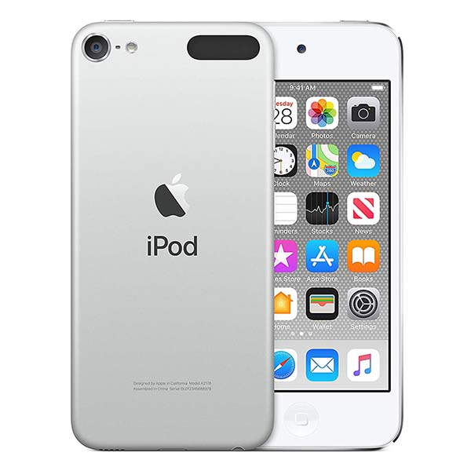
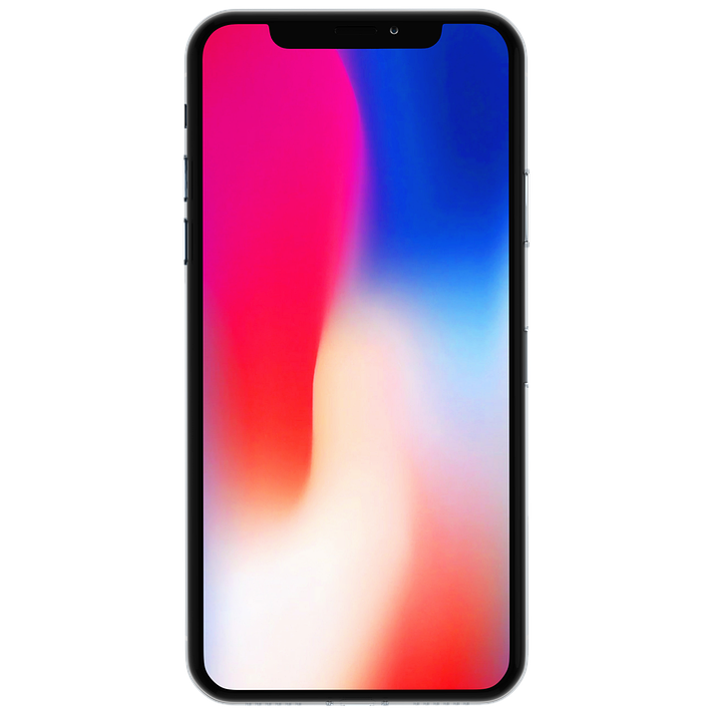
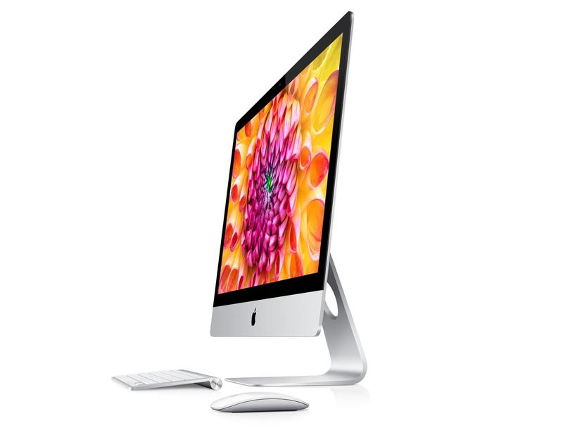
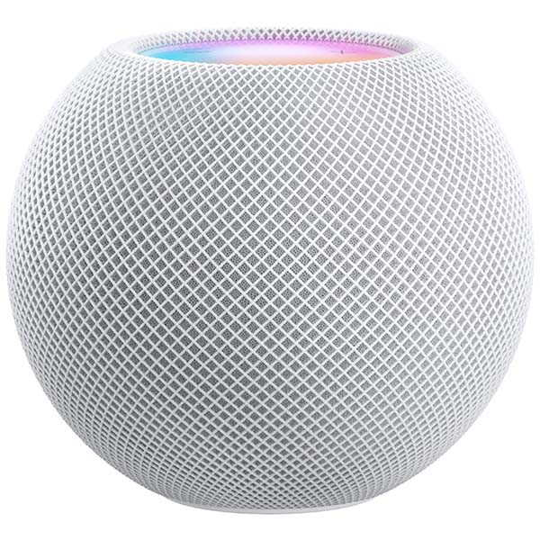

MARKET
GROWTH
QUESTIONS
STARS
ThePhoto di PhotoAuthor è concessa in licenza secondo CCYYSA.
DOGS
CASH COWS
MARKET SHARE

Slide 9
THANK YOU !

